Slide 1

Login Anomaly Detection - Splunk App
Splunk Build-a-thon 2025 Hackathon Project

Slide 2
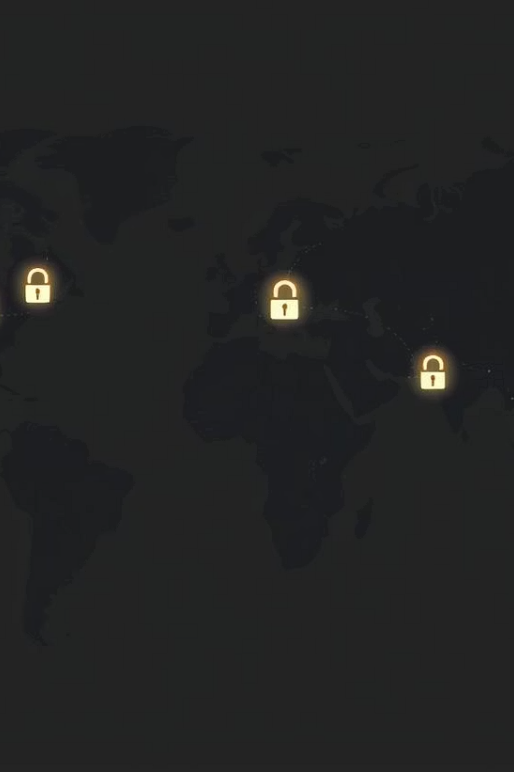
Real-time Login Monitoring with Splunk MLTK
Detecting unusual logins in real-time, built by CyberSentinels.
Team: Srinivas & Chaitanya Lahari (CyberSentinels)

Slide 3
The Challenge: Overlooking Threats
Traditional security rules often miss sophisticated login attacks.
1
Stealthy Brute-Force
2
Undetected Impossible Travel
3
Delayed Failure Spikes
Blends in with normal traffic, bypassing simple thresholds.
Geographically improbable logins within minutes go unnoticed.
Sudden surges in login failures aren't flagged promptly.

Slide 4



Our Mission: Automated Anomaly Detection
Automatic Identification
Immediate Alerts
Clear Visualizations
Notify security teams instantly to enable rapid response.
Proactively spot malicious login attempts without manual review.
Present actionable insights on intuitive dashboards.

Slide 5
The Five-Step Anomaly Detection Process
Data Ingestion
Raw login records are loaded from CSV for processing.
Feature Engineering
Login data transforms into quantifiable metrics.
Behavioral Clustering
Machine learning groups similar login patterns.
Real-time Alerting
Suspicious clusters and impossible travel trigger immediate alerts.
Interactive Dashboard
Results displayed for quick security team review.

Slide 6




Key Behavioral Features
We analyze four crucial metrics for each user's login activity.
Login Hour
Failure Ratio
Time of day the login occurred.
Proportion of failed attempts per session.
Total Logins
Unique IP Count
Overall login attempts within a specific session.
Number of distinct IP addresses used rapidly.

Slide 7
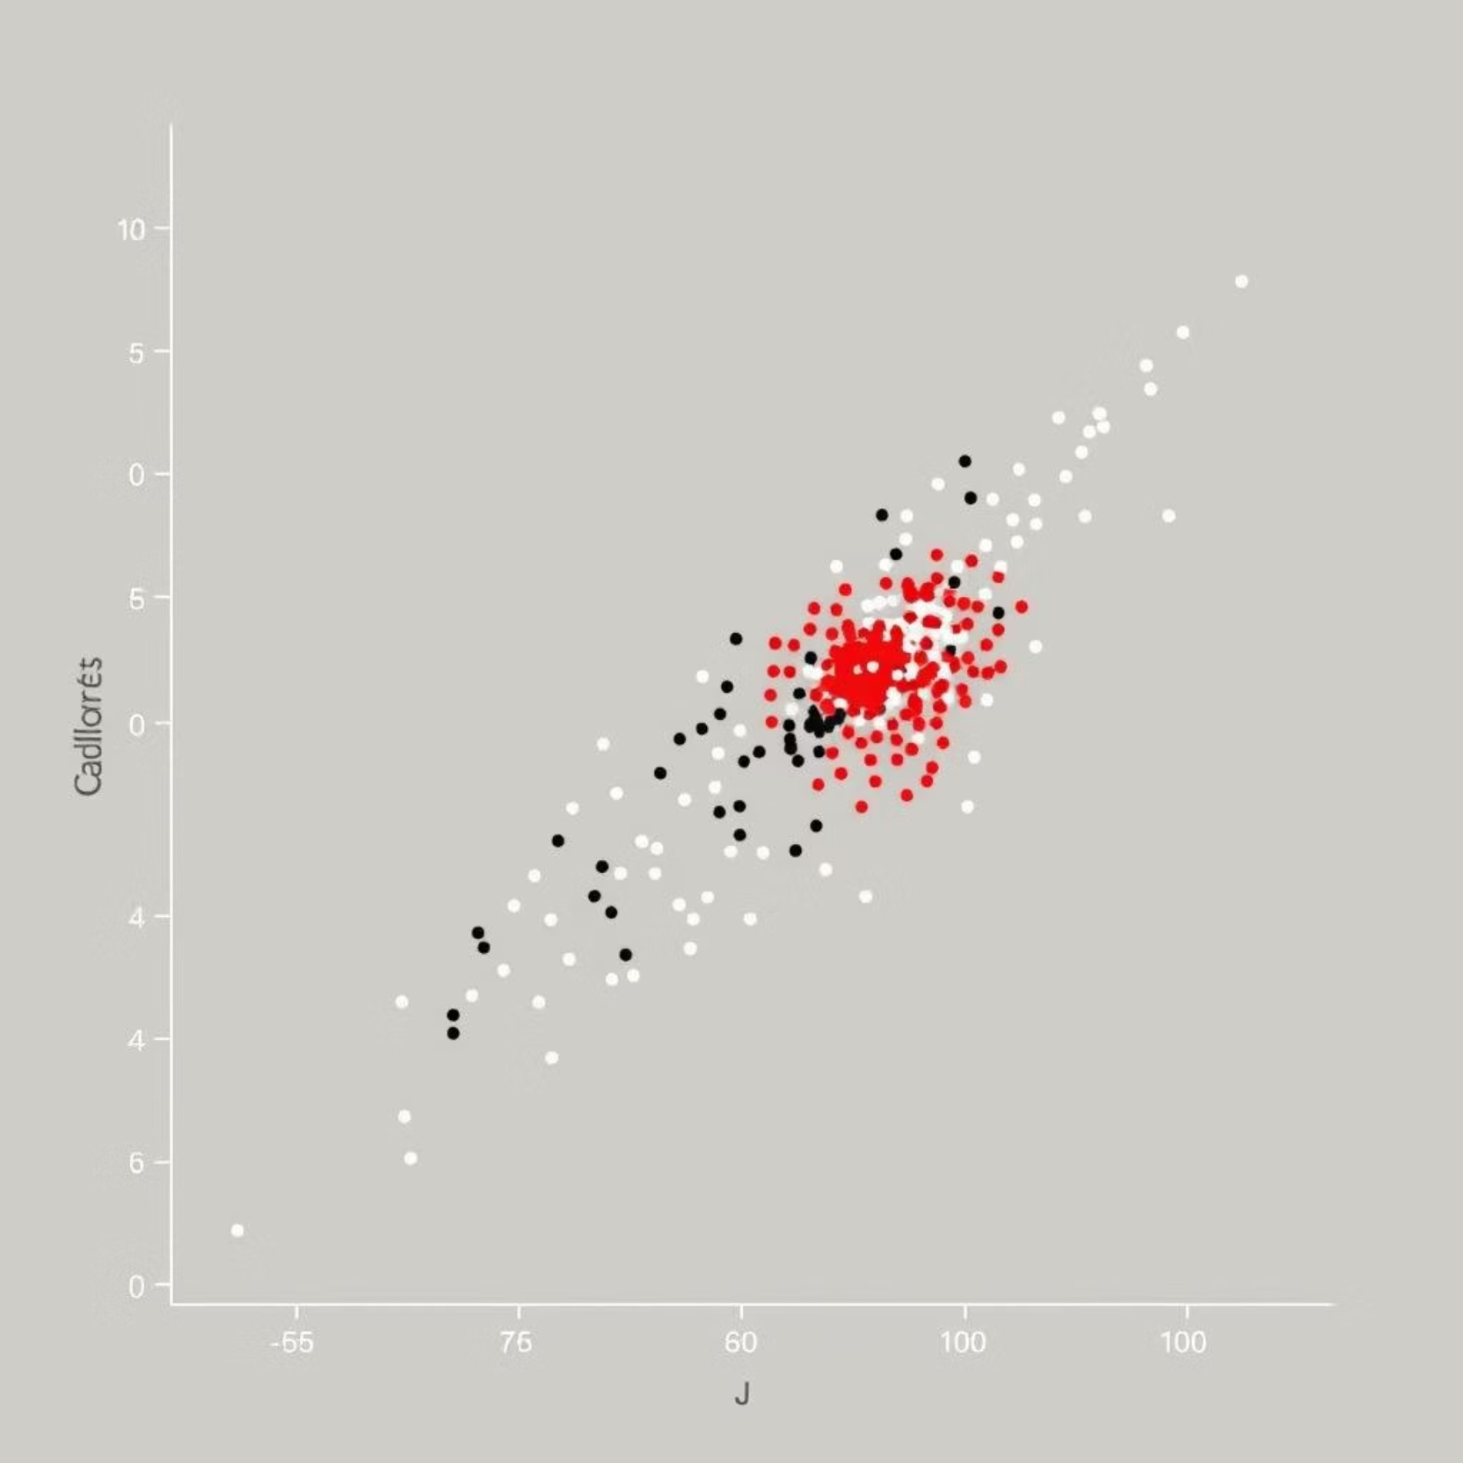
Identifying Anomalous Clusters
Our system groups all login behaviors into distinct clusters. One particular cluster consistently highlights anomalous activity.
It exhibits a high frequency of login failures.
Multiple unique IP addresses are observed within a short timeframe.
This "suspicious" group, designated as Cluster 0, flags potential attackers by deviating significantly from normal user patterns.

Slide 8
Automated Alert Mechanisms
Two types of alerts provide immediate notification of unusual activity.
1. Cluster Alert
2. Impossible Travel Alert
Trigger: Login falls into the suspicious Cluster 0.
Trigger: Same user logs in from two distant countries within 60 seconds.
Response: Email notification sent, event marked on dashboard.
Response: Event tagged as "Impossible Travel" on dashboard.
index=main sourcetype="csv"| eval login_hour = tonumber(strftime(_time, "%H"))| stats count as total_logins, sum(eval(action="failure")) as failures by user, login_hour| eval failure_ratio = failures / total_logins| apply login_anomaly_kmeans_model| where cluster = 0
| inputlookup synthetic_auth_logs.csv | sort user, _time | streamstats window=1 last(country) AS prev_country last(_time) AS prev_time BY user | eval diff_seconds=_time - prev_time | where country!=prev_country AND diff_seconds<60 | eval alert="Impossible Travel"

Slide 9
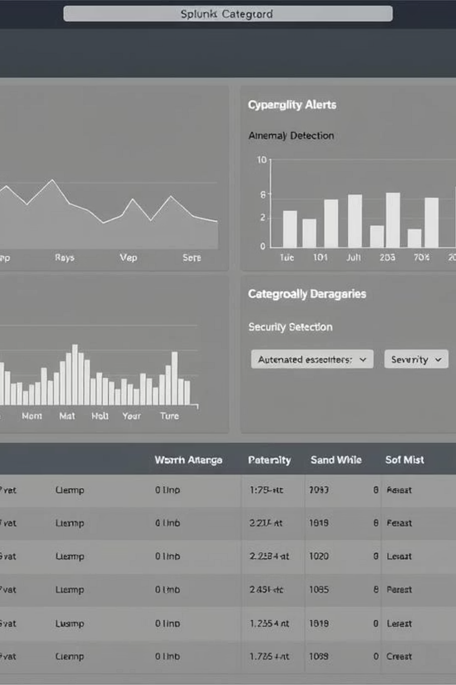
Intuitive Live Dashboard
Our dashboard provides seven panels for comprehensive, real-time insights.
1. Activity Over Time
4. Cluster View
6. Alert Trends
Visualizes success and failure rates.
Compares suspicious vs. normal logins.
Shows how alerts change over time.
2. Top Users
5. Failure Scatter Plot
7. High-Risk Users
Identifies most active users.
Maps users with high failure rates.
Lists flagged users in a detailed table.
3. Hourly Heatmap
Highlights peak login hours.

Slide 10
Impact & Value Proposition
Prevent Brute-Force Attacks
Detect Account Takeovers
Stop unauthorized access attempts proactively.
Identify and respond to compromised accounts instantly.
Simplify Audits & Compliance
Empower Security Teams
Provide clear, detailed logs for regulatory requirements.
Reduce manual workload, allowing focus on critical threats.

Slide 11
Thanks for reviewing
secure every login with us!
GitHub: https://github.com/srinivas0307/Login-Anomaly-Detection-App
Emails:
• Srinivas: srinivasbilluri2005@gmail.com
• Chaitanya Lahari: gurramlahari84@gmail.com

